Slide 1
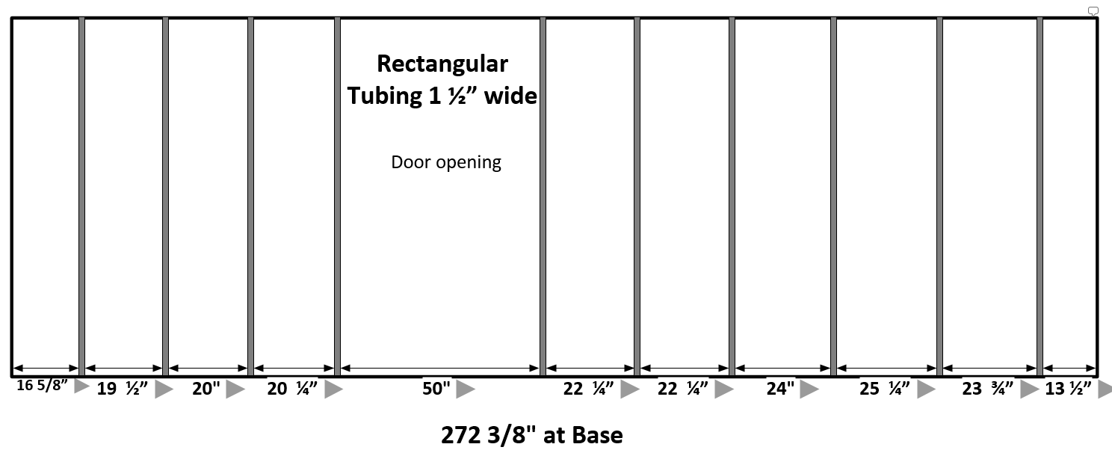
Estimated spacing needed for metal framing

Slide 2
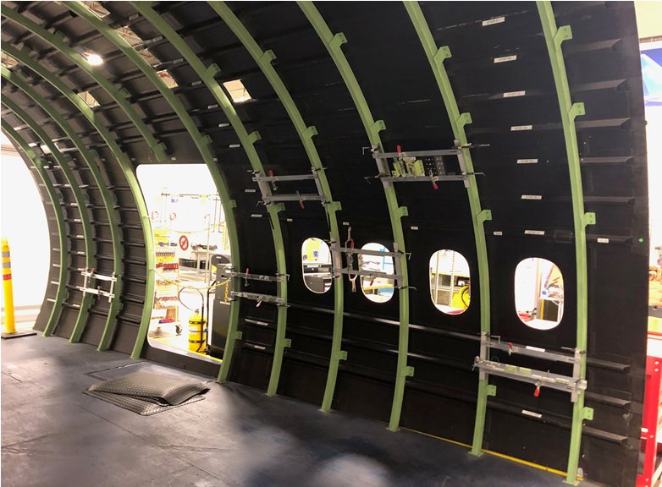
Metal framing needed for Third floor Barrel piece

Slide 3
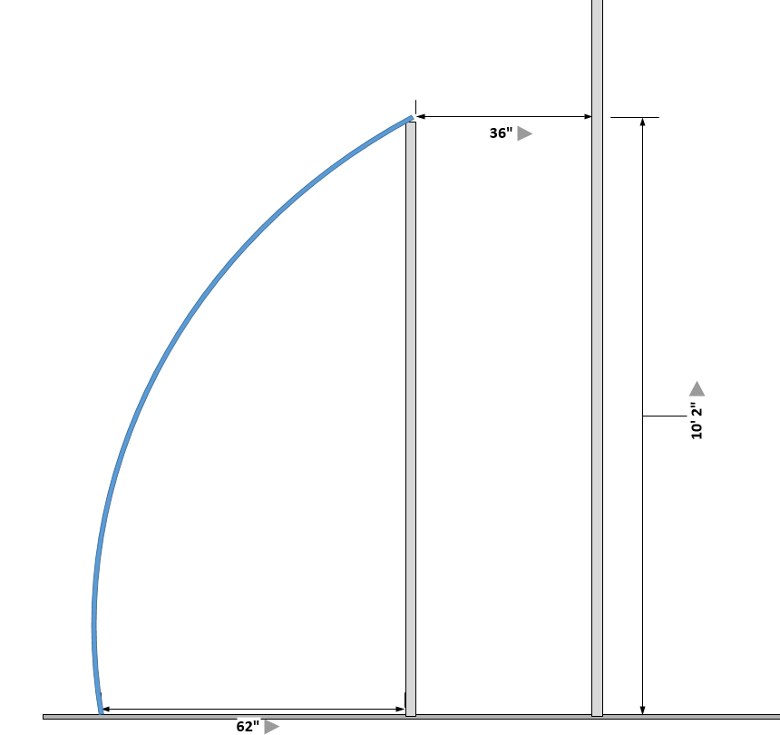
Third Floor Barrel section
Barrel section
Metal support Beams
Bldg. wall

Slide 4
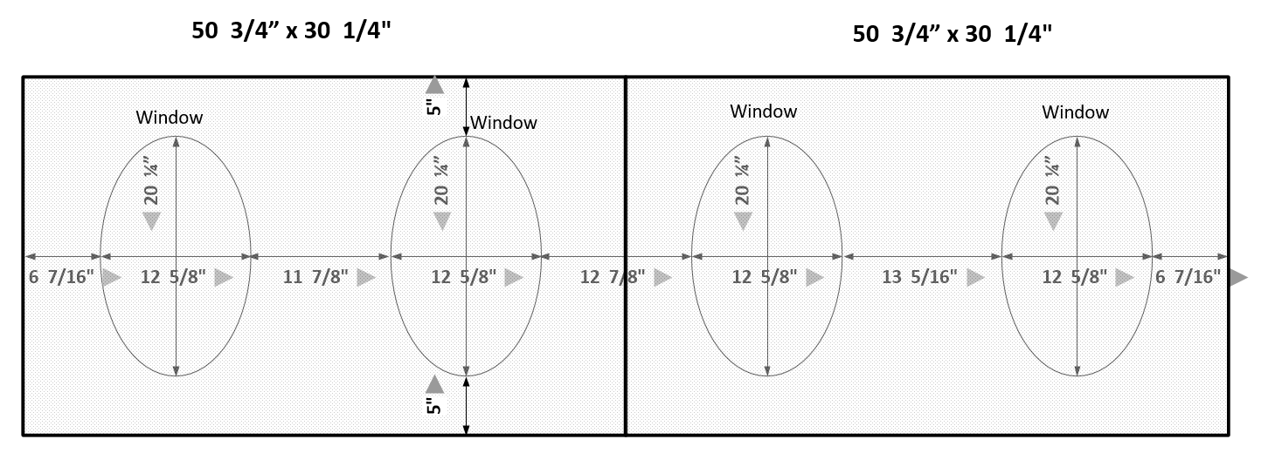
Specification for Window Panel Cutout

